Slide 1
Evaluating pH-sensitization of immunotherapy treatment regimens with noninvasive
Chemical Exchange Saturation Transfer (CEST) MRI
Sanhita Sinharay
(joining BSSE as an Assistant Professor in early 2021)
https://faculty.mdanderson.org/profiles/sanhita_sinharay.html

Slide 2
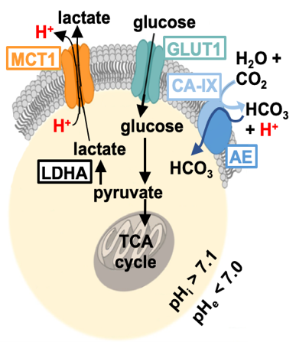
Aggressive tumors are acidic
Tumor cells exhibit upregulated glycolysis even under aerobic conditions, and this upregulated glycolysis produces lactic acid in tumor cells, that is neutralized or secreted from the cells to maintain intracellular homeostasis, causing the extracellular tumor microenvironment to become acidic.
Tumor acidosis causes resistance to immunotherapy
Immunotherapy is emerging as a promising option for treating cancer. However, extracellular acidosis of the local tumor microenvironment causes resistance to immunotherapy (overall only 15-20% response to immunotherapy observed in most cancers) and in short, tumor acidosis acts as a “protective shield” that cancer cells can use to erase anti-tumor immune effectors and convert regulatory immune cells to pro-tumor allies.
Early alkanization therapies (bicarbonate treatment) showed improved response however failed clinical trials due to kidney damage.
Biochemistry of extracellular tumor acidosis showing the various pH-regulators that help to maintain a neutral intracellular pH (pH_{i}) and acidic extracellular pH (pH_{e})
Can neutralization of extracellular tumor acidosis (with pH-regulator inhibitors) potentially sensitize tumor cells to improved immunotherapy response ?

Slide 3
CEST MRI for noninvasive pH_{e} measurement
Project outline
A
B
CEST contrast agent
A: Principle of noninvasive CEST MRI and corresponding CEST spectrum from iopamidol, a CEST MRI contrast agent that can detect pH_{e} by ratiometric comparison of two amide (N-H) CEST signals.
B: CEST MRI can be used to noninvasively measure tumor pHe in a control and tumor with high carbonic anhydrase-IX (CA-IX)expression.

Slide 4
Major techniques/skills students will learn
Engineering and designing of CEST MRI contrast agents that are responsive to change in pH (or other biomarkers in general)
MRI data fitting and data analysis
Cell culture, in vitro assay development, animal handling
Development of in vivo tumor models
In vivo MRI including operation of Siemens 3T MRI scanner
Immunotherapy
Further reading
Pilon-Thomas, Shari, et al. "Neutralization of tumor acidity improves antitumor responses to immunotherapy." Cancer research 76.6 (2016): 1381-1390
Anemone, Annasofia, et al. "Tumour acidosis evaluated in vivo by MRI-CEST pH imaging reveals breast cancer metastatic potential." British journal of cancer (2020): 1-10

