Slide 1
Bioinspired Nanostructured Bactericidal Surfaces
Kaushik Chatterjee
Lab Website: https://sites.google.com/site/iiscbiomaterials/
Email: kchatterjee@iisc.ac.in

Slide 2
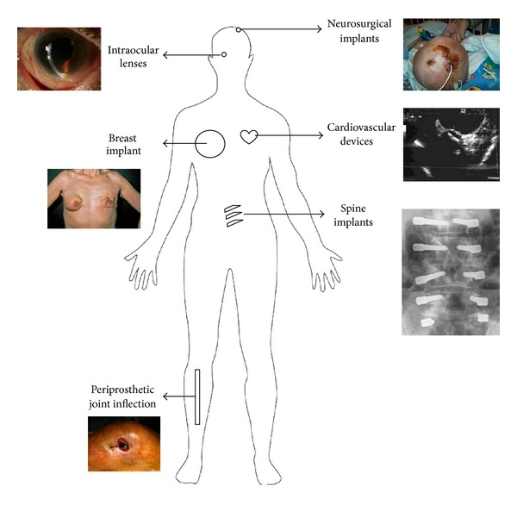
Infections Associated With Medical Devices
BioMed Research International 2013(1):804391

Slide 3

Antimicrobial Resistance
https://www.biomerieux.com/en/resistance-antibiotics-0

Slide 4
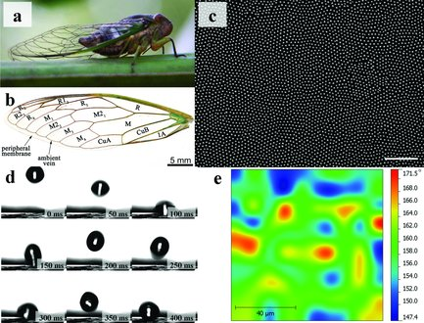
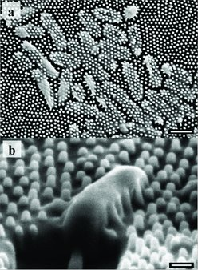
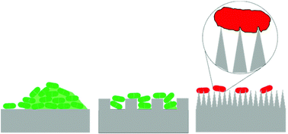
Bactericidal Natural Surfaces: Insect Wings
Biofilm formation
Anti-biofouling
Bactericidal
Small . 2012 Aug 20;8(16):2489-94

Slide 5
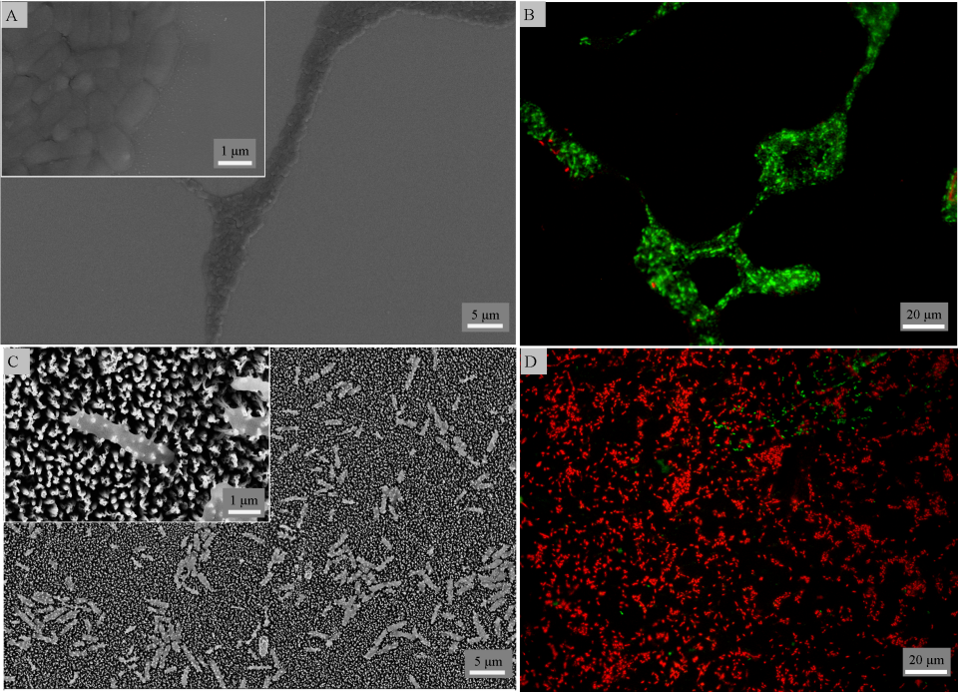
Bioinspired Mechano-bactericidal Surface Nanostructures
Smooth
Ti Surface
Nanostructured
Ti Surface
SEM image
Fluorescent
(live/dead) image

Slide 6
Objectives
Prepare bactericidal nanostructures on biomedical alloys (other than commercially pure Ti)
Prepare bactericidal nanostructures on biomedical polymers
Fabrication of bactericidal nanostructures on 3D printed metallic and polymeric implants/ scaffolds
Modeling bacteria-nanostructure interactions
In vivo testing of bactericidal efficiency of the nanostructures

Slide 7
Relevant publications from the group
J. Hasan, S. Jain, R. Padmarajan, S. Purighalla, V.K. Sambandamurthy, K. Chatterjee: “Multi-scale surface topography to minimize adherence and viability of nosocomial drug-resistant bacteria” Materials & Design 2018, 140: 332-344
J. Hasan, S. Jain, K. Chatterjee “Nanoscale topography on black titanium imparts multi-biofunctional properties for orthopedic applications” Scientific Reports 2017, 7: 41118
J. Hasan, S. Raj, L. Yadav, K. Chatterjee: “Engineering a nanostructured “super surface” with superhydrophobic and superkilling properties” RSC Advances 2015, 5: 44953–44959
D. Patil, M. Overland, M. Stoller, K. Chatterjee: “Bioinspired nanostructured bactericidal surfaces” Current Opinion in Chemical Engineering 2021, 28: 100741
A. Roy, K. Chatterjee: “Theoretical and computational investigations into mechanobactericidal activity of nanostructures at the bacteria-biomaterial interface: A critical review” Nanoscale 2021: 13, 647–658
J. Hasan, A. Roy, K. Chatterjee, P.K.D.V. Yarlagadda: “Mimicking insect wings: The roadmap to bio-inspiration” ACS Biomaterials Science and Engineering 2019, 5: 3139−3160
J. Hasan, K. Chatterjee: “Recent advances in engineering topography mediated antibacterial surfaces” Nanoscale 2015, 7: 15568–15575

